Slide 1
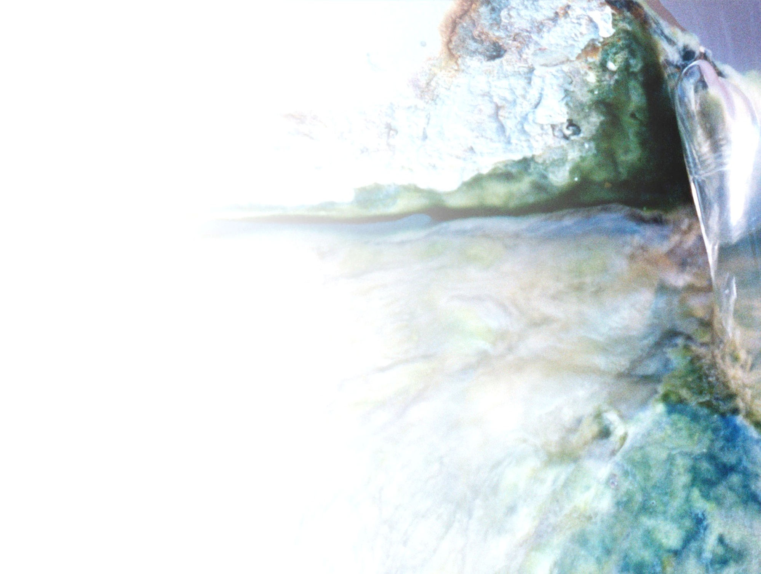


Hands-on:
Microbial community analysis using the ampvis2 package
MiDAS course 2025

Slide 2

Structure of the hands-on
Install R and Rstudio (if not done)
Install ampvis2 in Rstudio
Download data from github (add address)
Load data
Explore data!

Slide 3
Install R and Rstudio
Download R: https://mirrors.dotsrc.org/cran/
Download Rstudio: https://posit.co/download/rstudio-desktop/#download
See guide: https://www.geeksforgeeks.org/how-to-install-r-studio-on-windows-and-linux/

Slide 4


Install ampvis2 in Rstudio
Go to documentation: https://github.com/KasperSkytte/ampvis2
Install other packages in Rstudio
https://tidyverse.tidyverse.org/

Slide 5
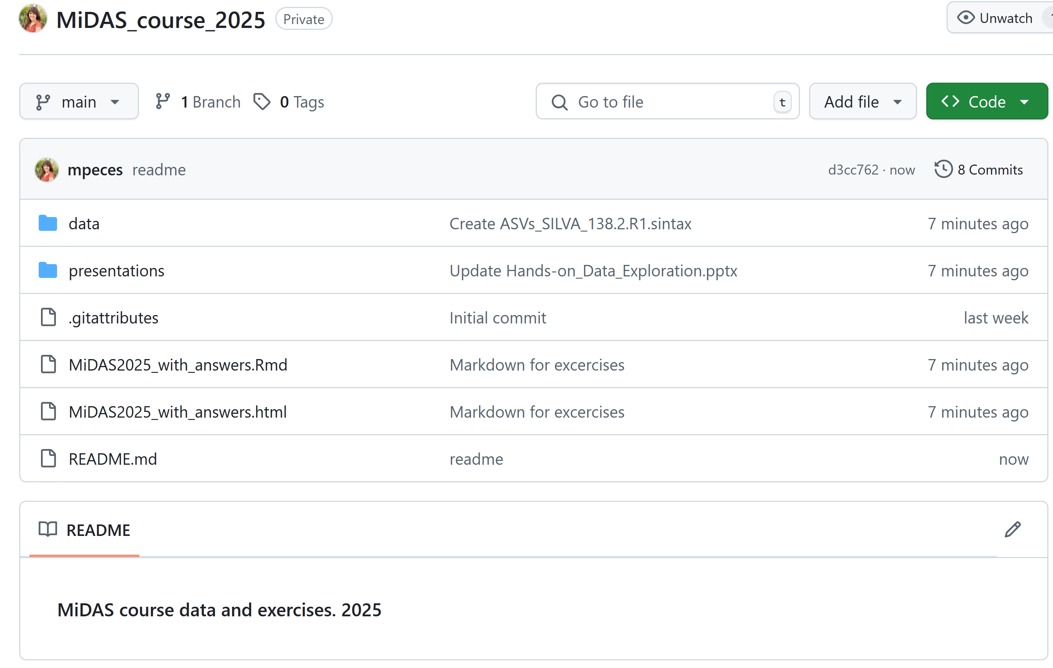
Find and download data
https://github.com/mpeces/MiDAS_course_2025

Slide 6
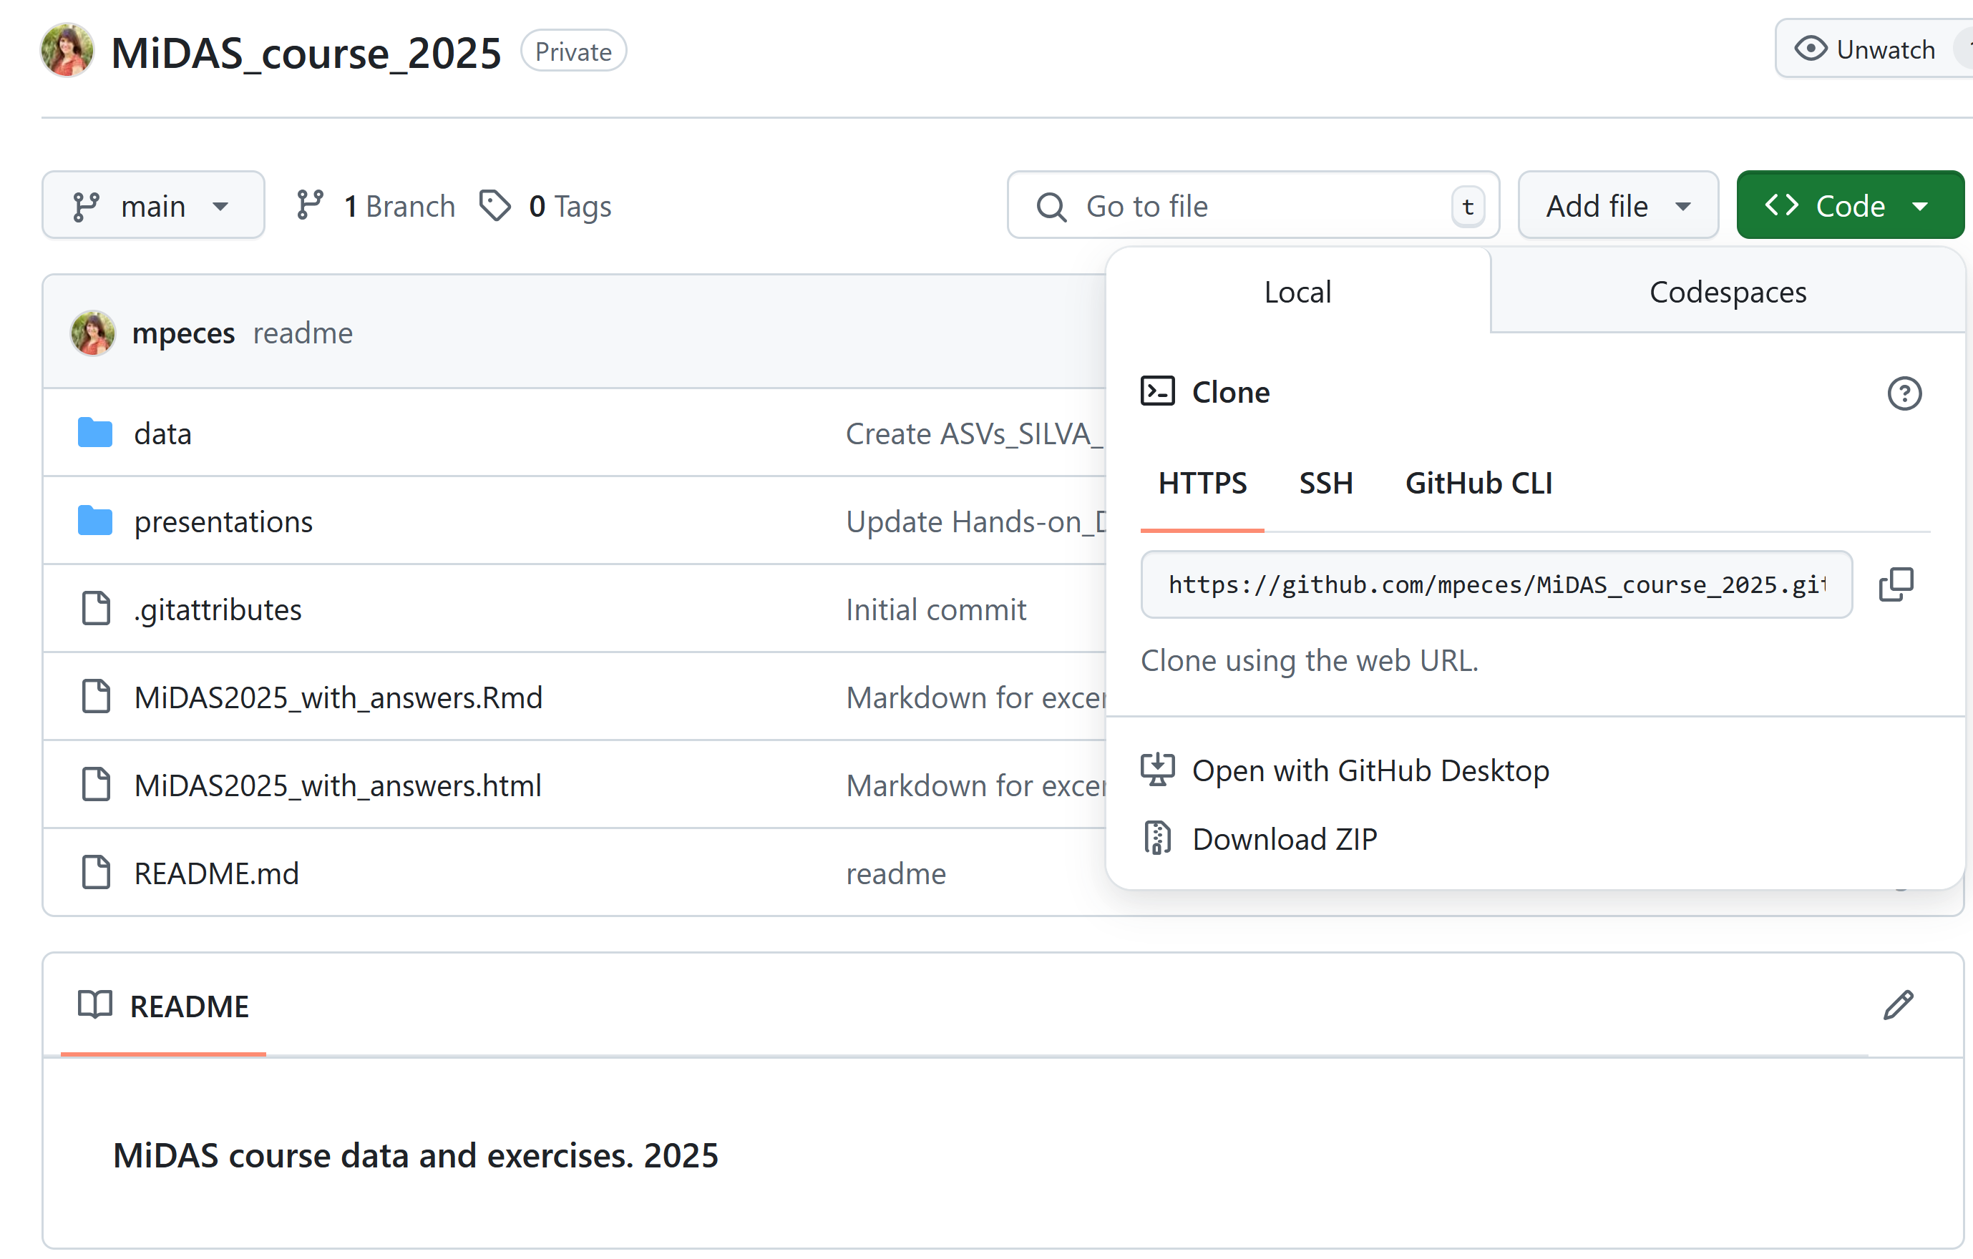
Find and download data
https://github.com/mpeces/MiDAS_course_2025

Slide 7
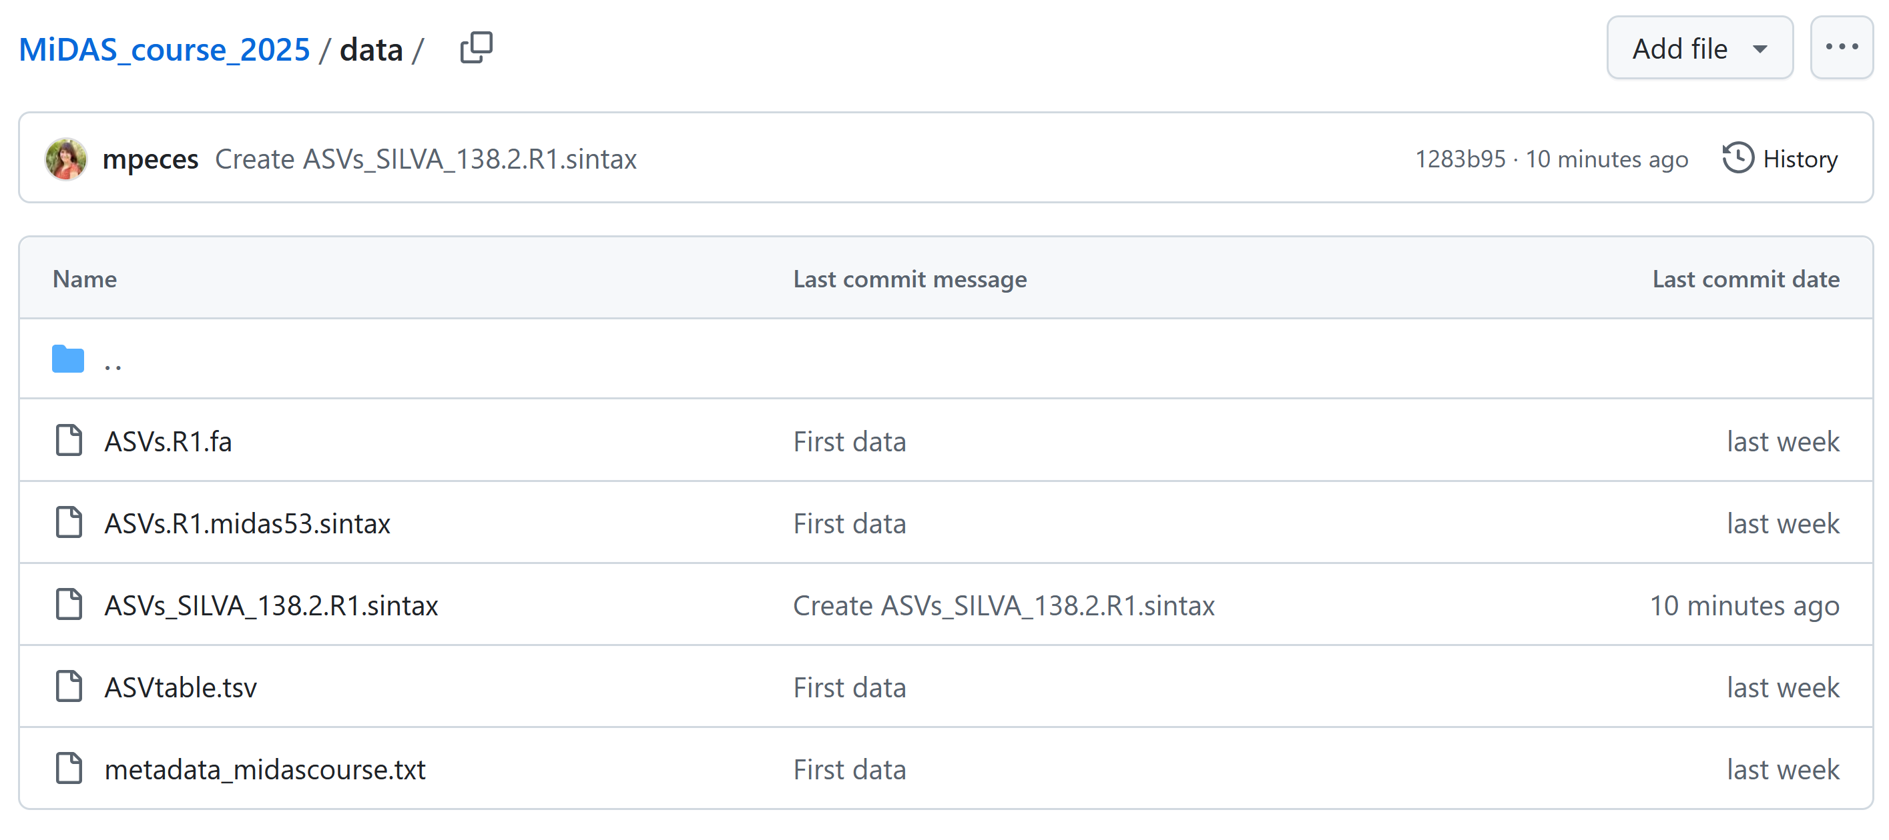
Find and download data
https://github.com/mpeces/MiDAS_course_2025
Raw ASVs
MiDAS 5.3 taxonomy
SILVA taxonomy
ASV table
Sample metadata

Slide 8
Install ampvis2 (https://kasperskytte.github.io/ampvis2/articles/ampvis2.html)
In the R terminal:
install.packages("remotes")
remotes::install_github("kasperskytte/ampvis2")
Other needed packages:
install.packages(“tidyverse")
Load packages (do for all packages):
library("ampvis2")
library(" tidyverse")

Slide 9
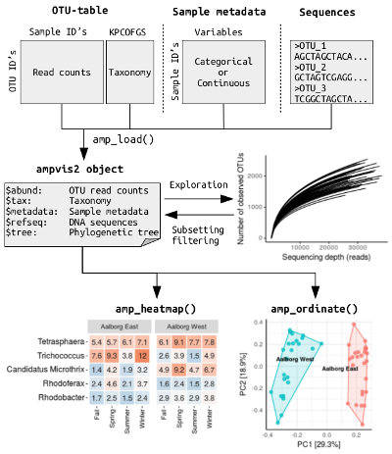
Load data into ampvis object
Metadata:
V13_metadata = 'data/V13_metadata.txt'
ASV table:
V13_ASVtab = 'data/V13_ASVtab.txt'
Taxonomy:
V13_tax = 'data/V13_ASV_MiDAS_5.3.sintax'
ASVs (fasta sequences):
ASV='data/V13_ASV.fa'
Load into ampvis:
d13 <- amp_load(otutable = V13_ASVtab,
taxonomy = V13_tax,
metadata = V13_metadata,
fasta = ASV)
(optional)

Slide 10
Typical amplicon analysis workflow in ampvis2

Slide 11
Break and R support

